Slide 1




CapStone Project
Amazon Product Review Analysis
Optimise inventory management by identifying the product categories on the customer review data Predict what kind of products could be in demand.
SYED MOHAMMED
AAYUSH GOEL
ABHISHEK JANJAL
Notes:
Source images : Powerpoint Stock Images

Slide 2

Sentiment segregation on the product
Top Brands on the base of sales
Regular Customers
Table of Contents
Category & Product
Season affecting the Sales
Forecasting the Sentiment For coming Years
Dashboard
How we Worked?
Notes:
Source images : Powerpoint Stock Images

Slide 3
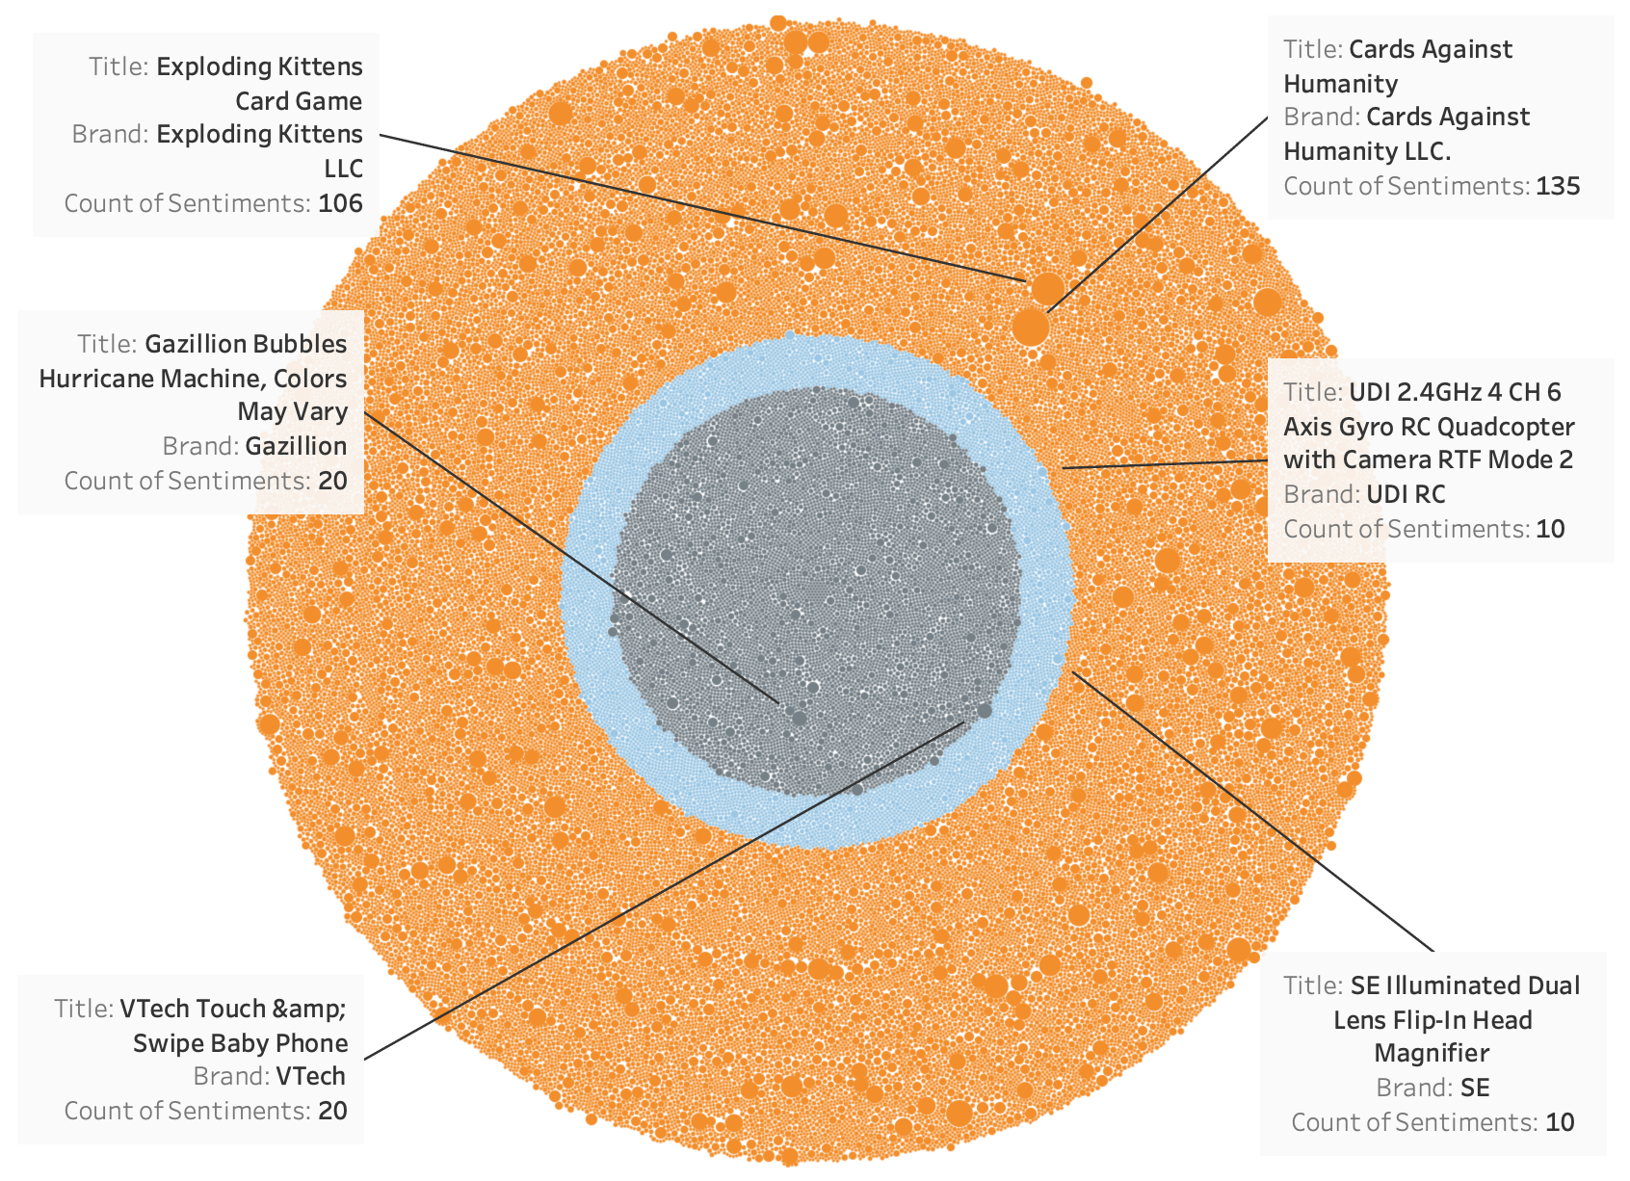
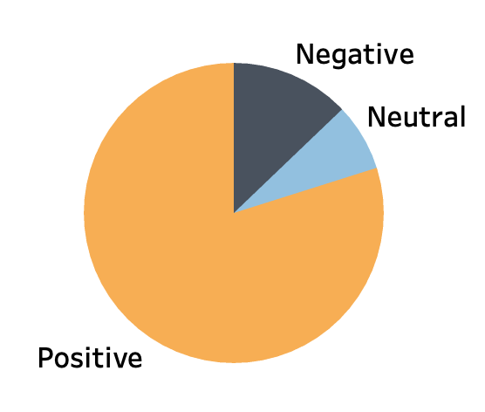
Sentiments over Video Game Product
12.85%
7.28%
79.87%
Notes:
Source images : Powerpoint Stock Images

Slide 4
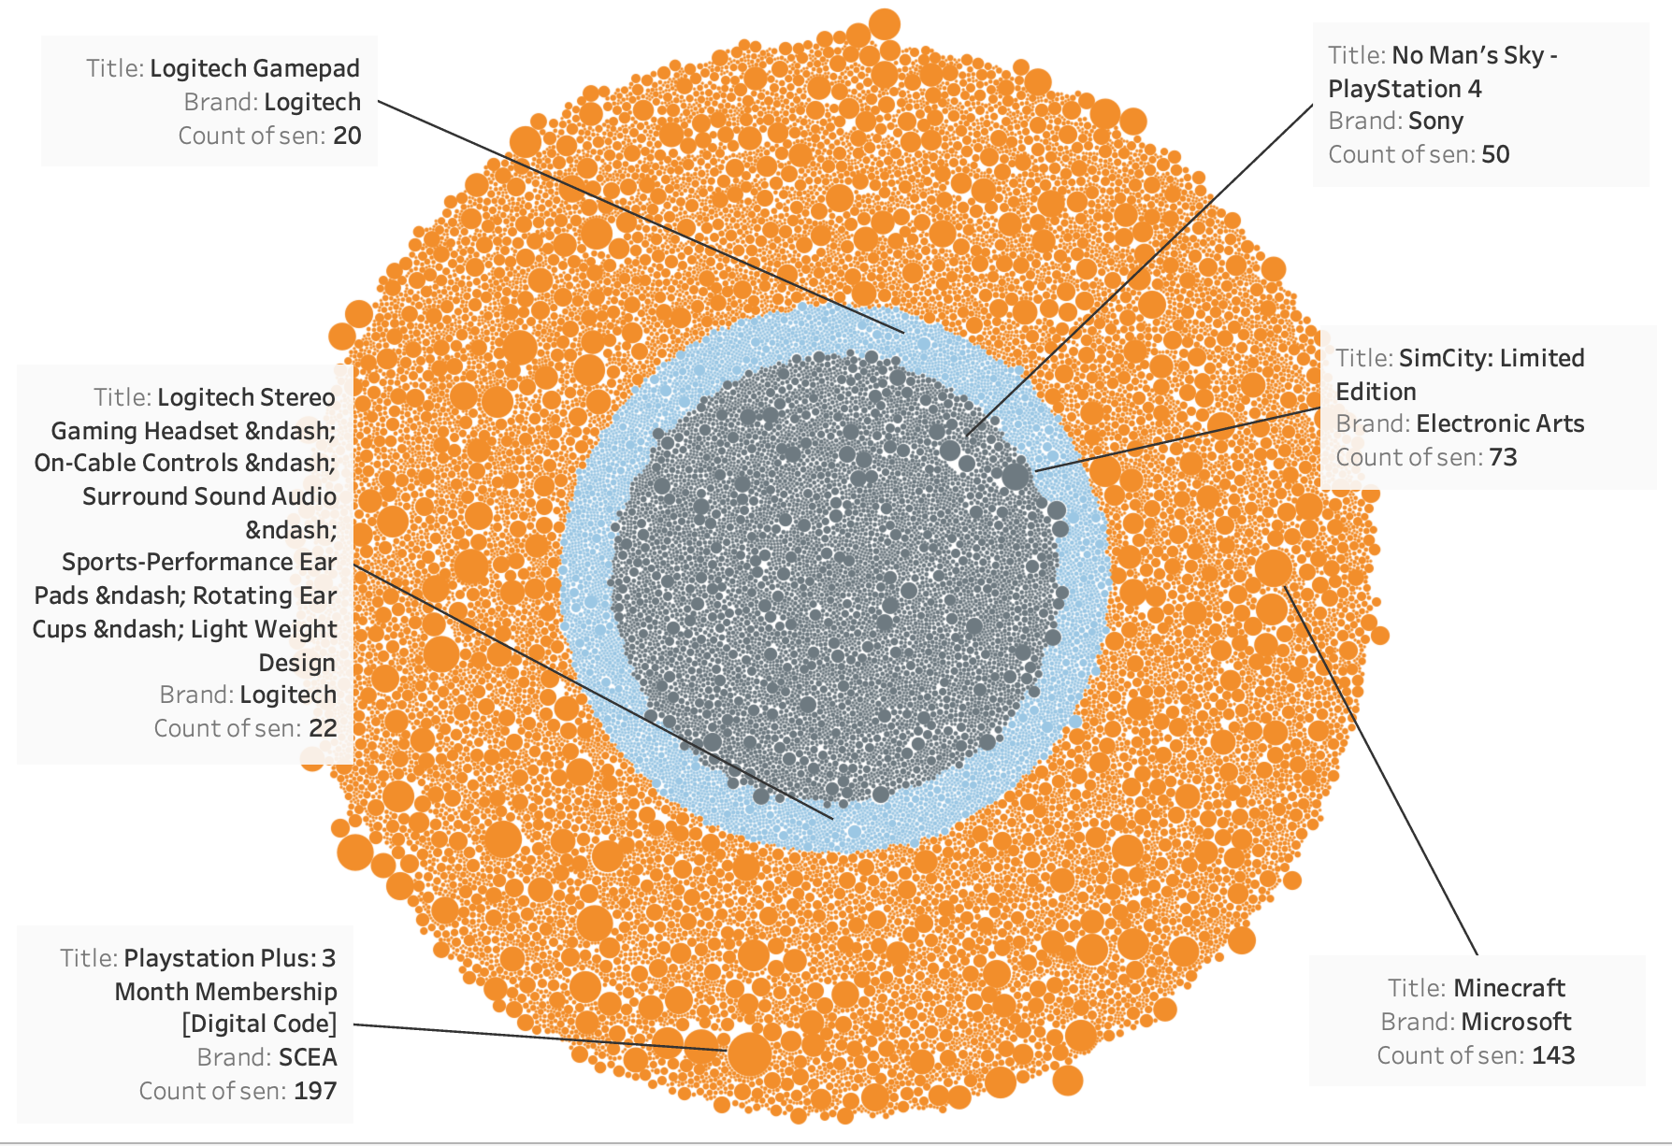
Sentiments over Toys & Game Product
17.17%
8.22%
74.61%
Notes:
Source images : Powerpoint Stock Images

Slide 5
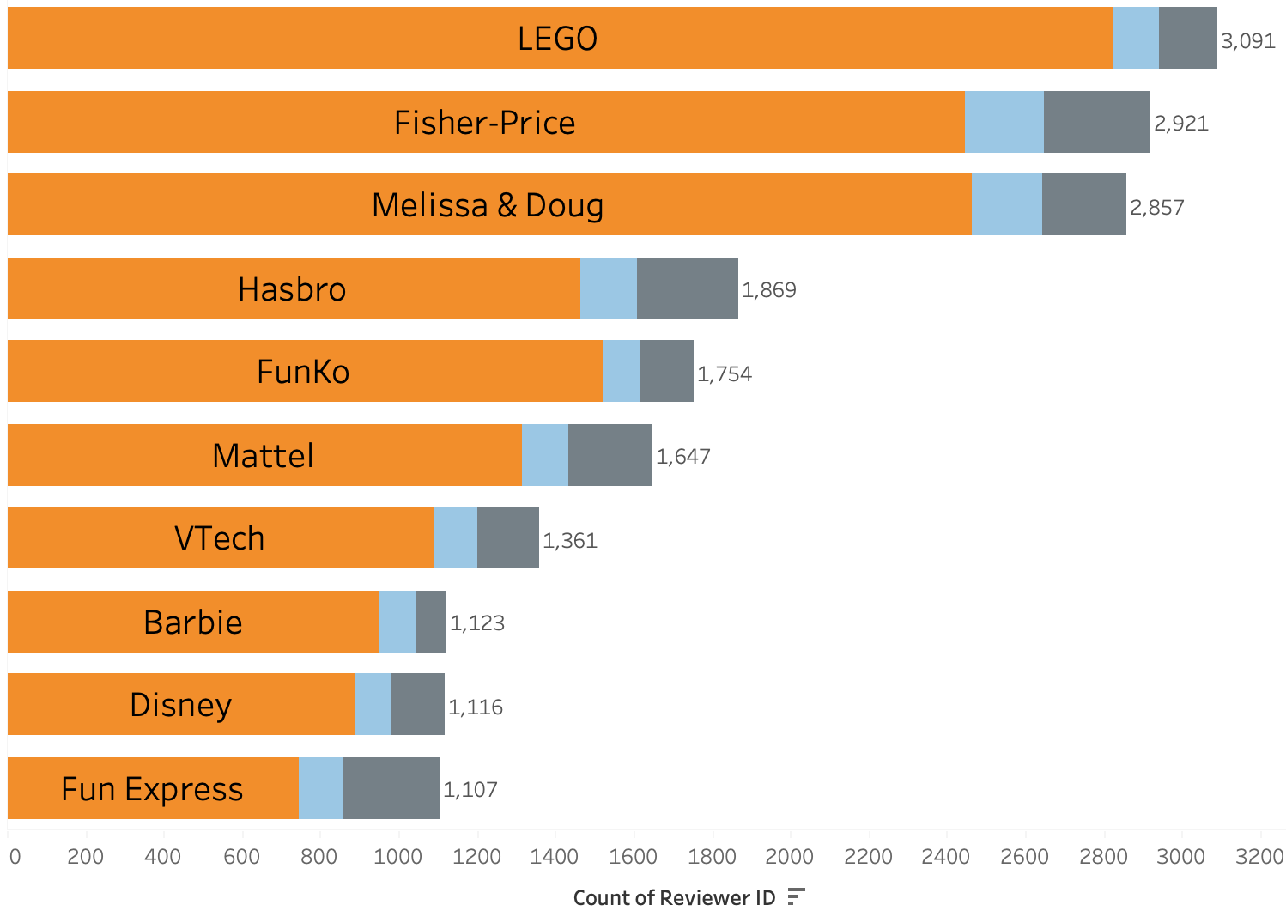
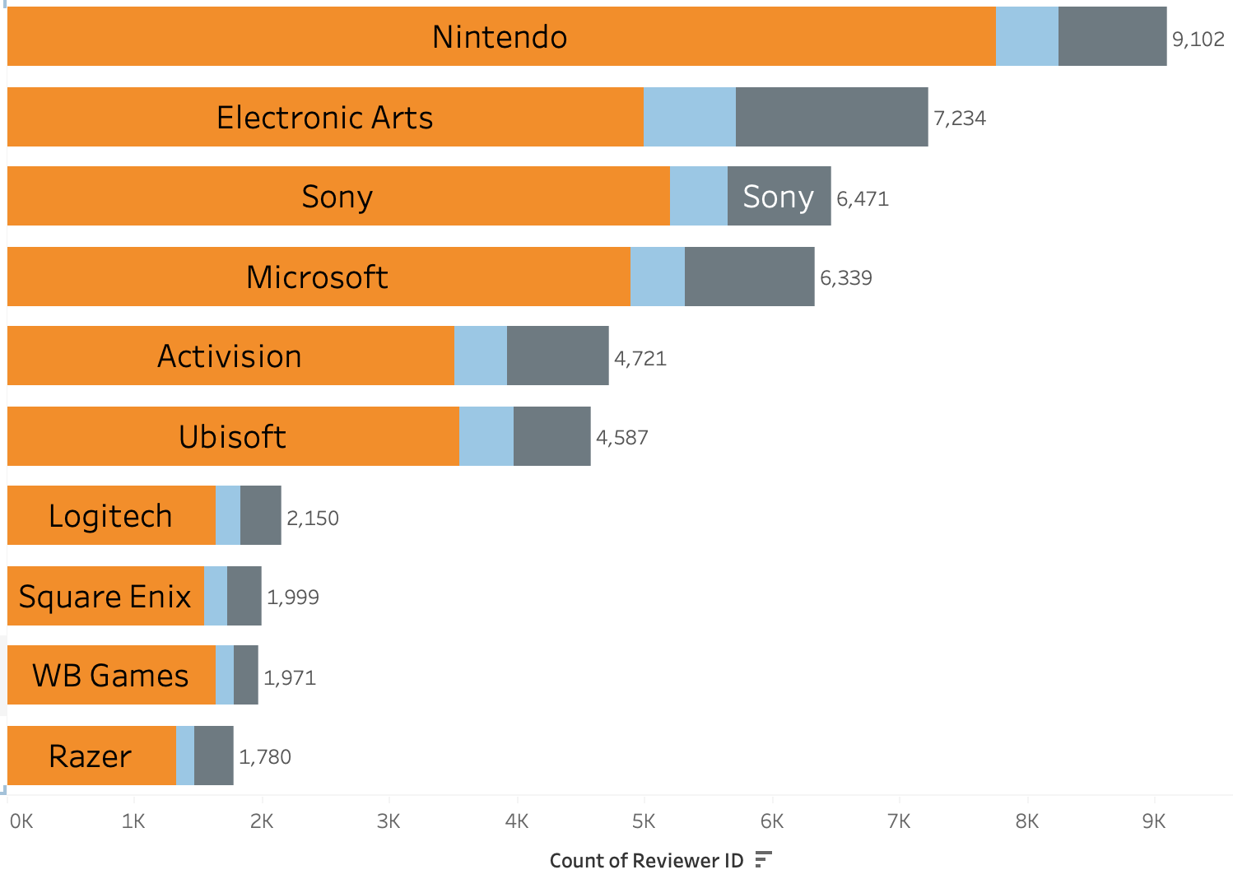

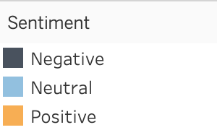
Toys & Game
Video Games
Top Brands
Notes:
Source images : Powerpoint Stock Images

Slide 6
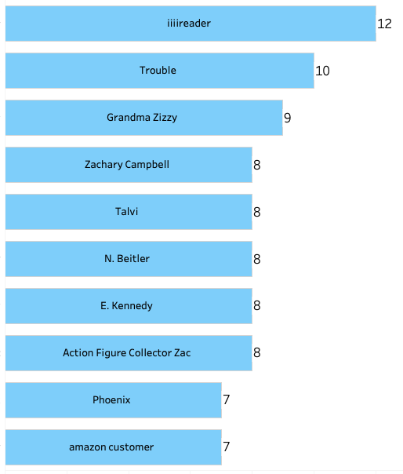
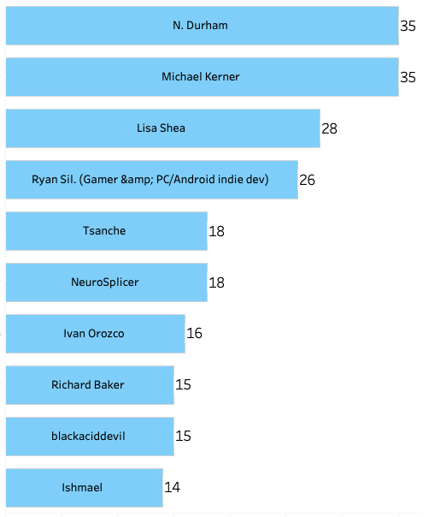
Toys & Game
Video Games
Regular
Customer
Notes:
Source images : Powerpoint Stock Images

Slide 7
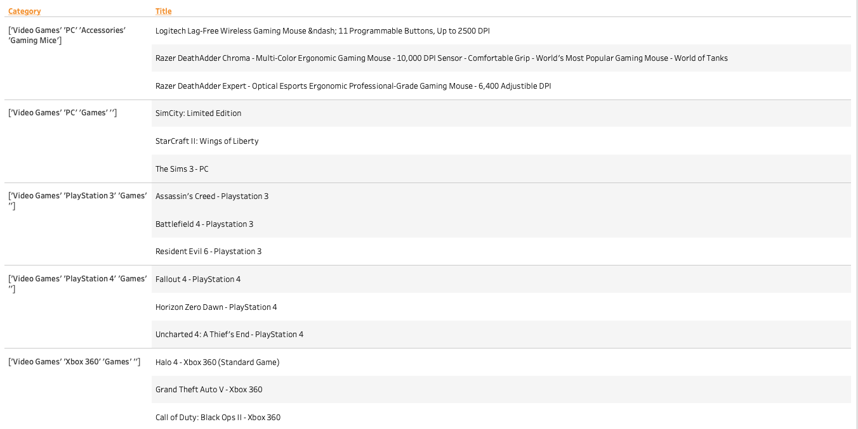
Video Games (Category & Product)
Notes:
Source images : Powerpoint Stock Images

Slide 8
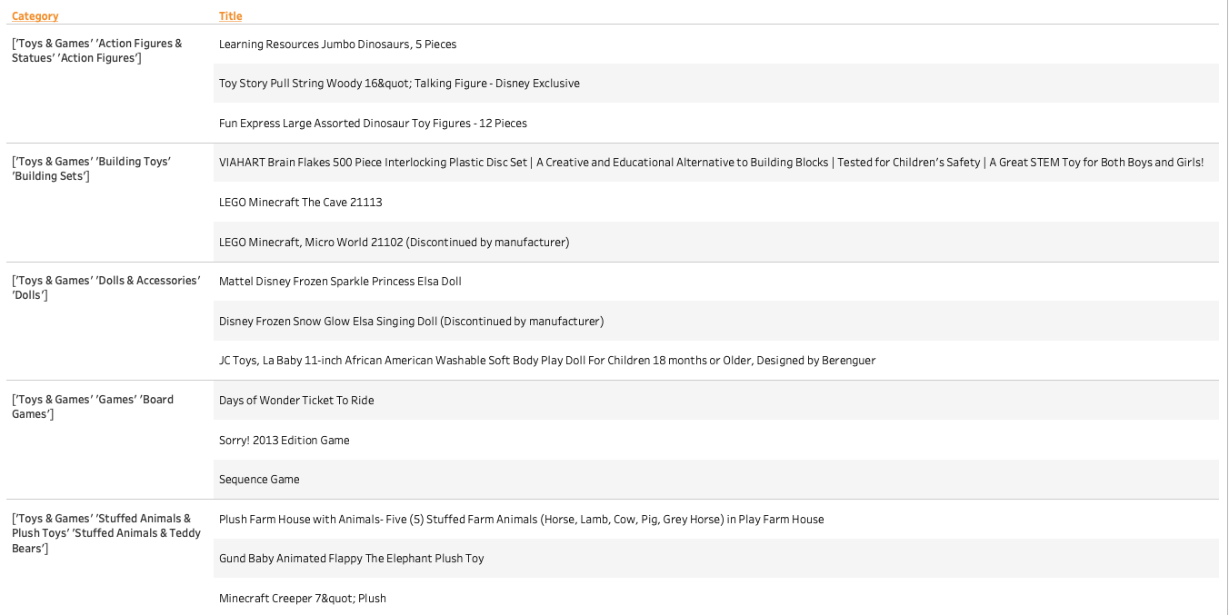
Toys & Games (Category & Product)
Notes:
Source images : Powerpoint Stock Images

Slide 9
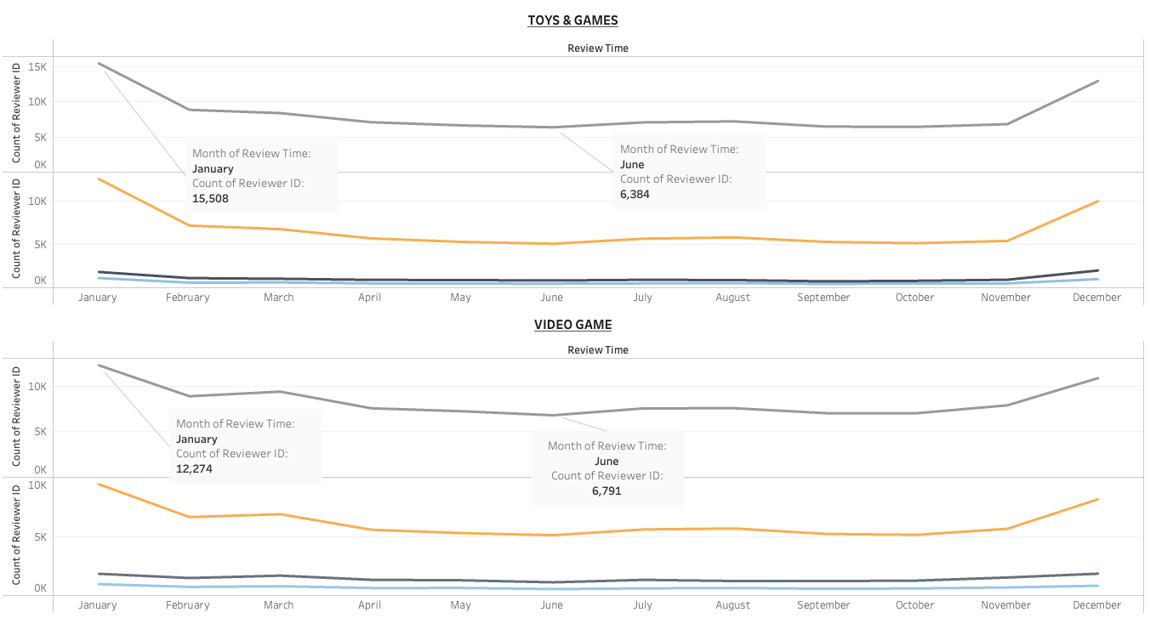
Seasonal
Sales
9
Notes:
Source images : Powerpoint Stock Images

Slide 10

Quote
“It’s tough to make predictions,
Especially about the future!”
—Yogi Berra
Notes:
Source images : <a href='https://www.freepik.com/photos/business'>Business photo created by drobotdean - www.freepik.com</a>

Slide 11
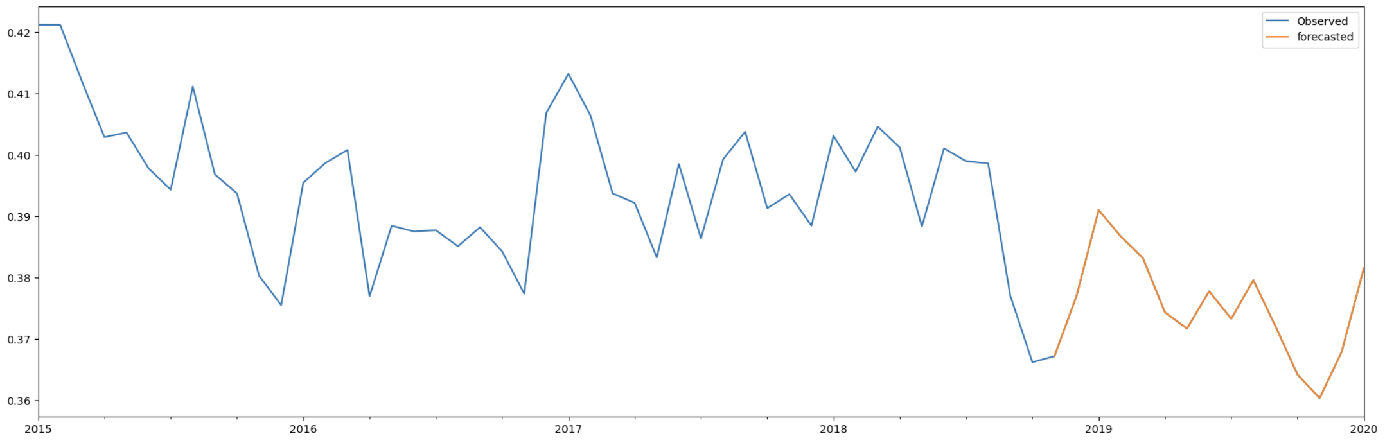
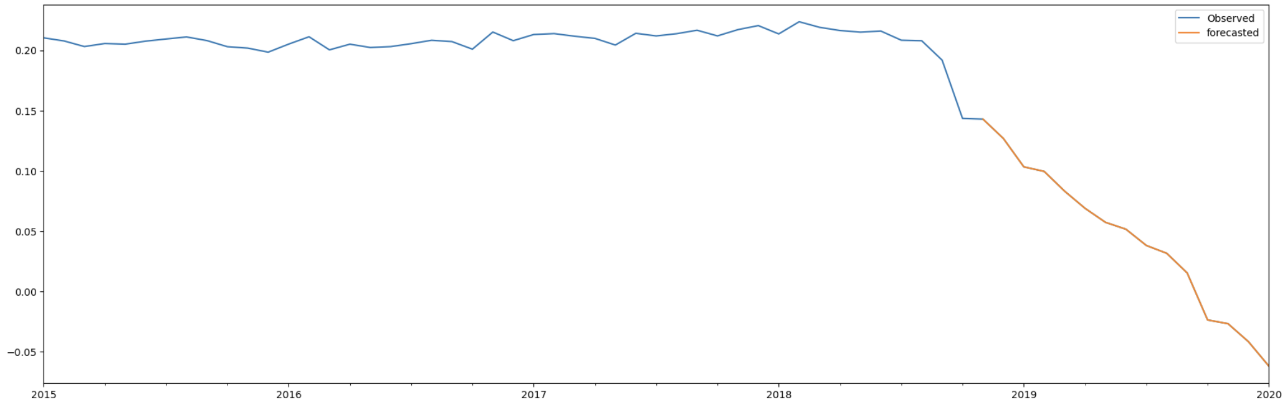
Video Game
Positive—————>
Negative—————>
11

Slide 12
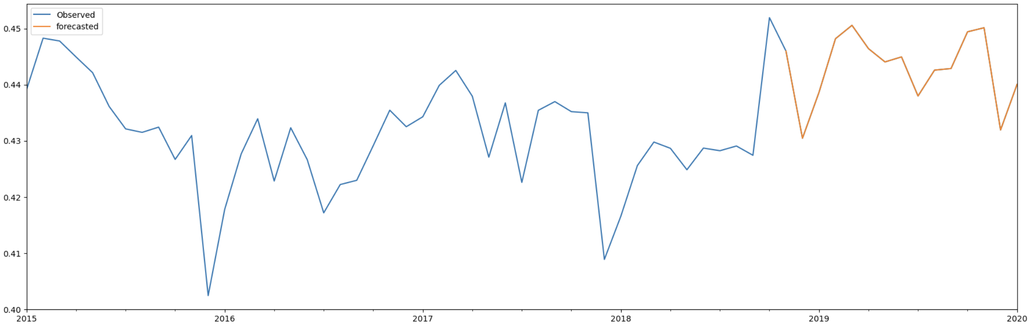
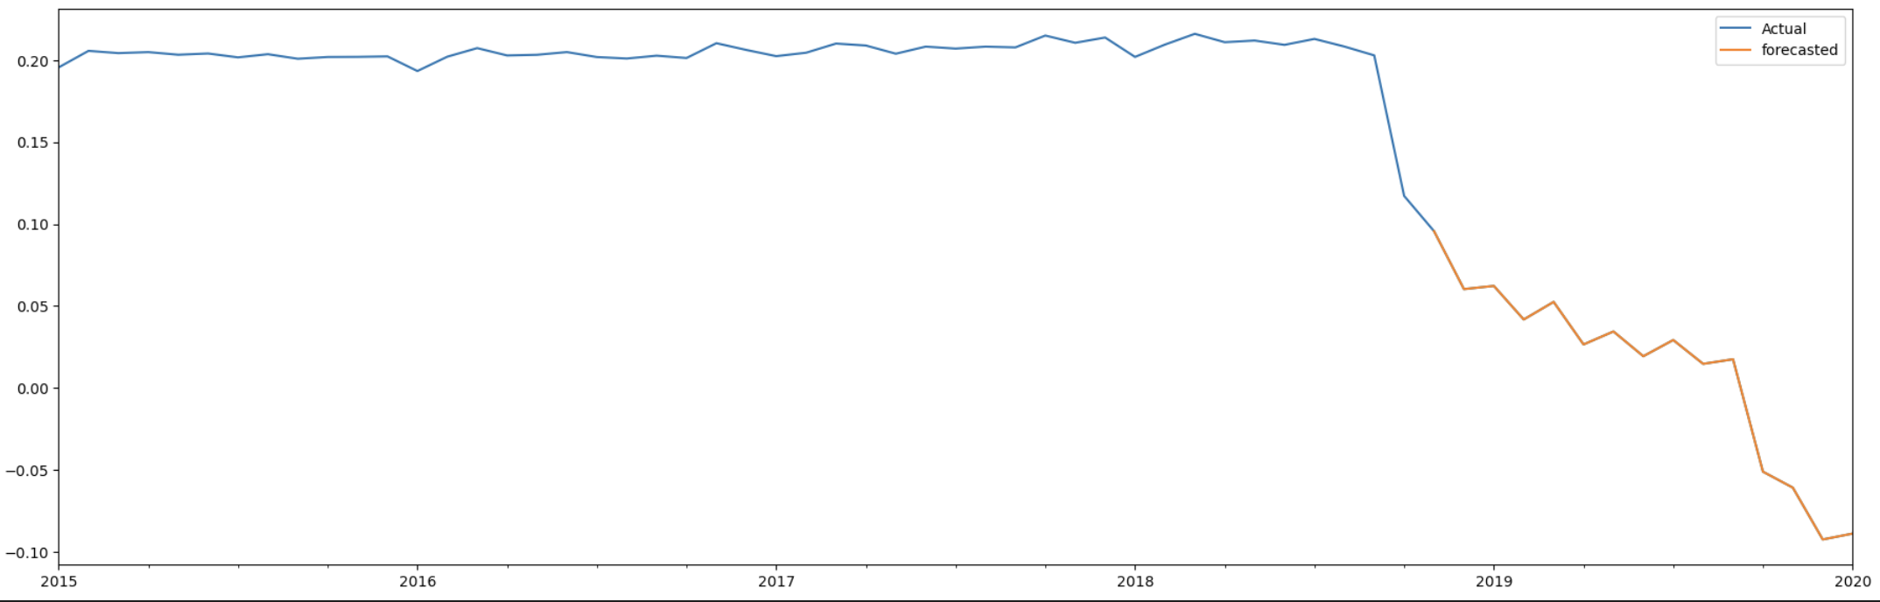
Toys & Game
Positive—————>
Negative—————>
12

Slide 13
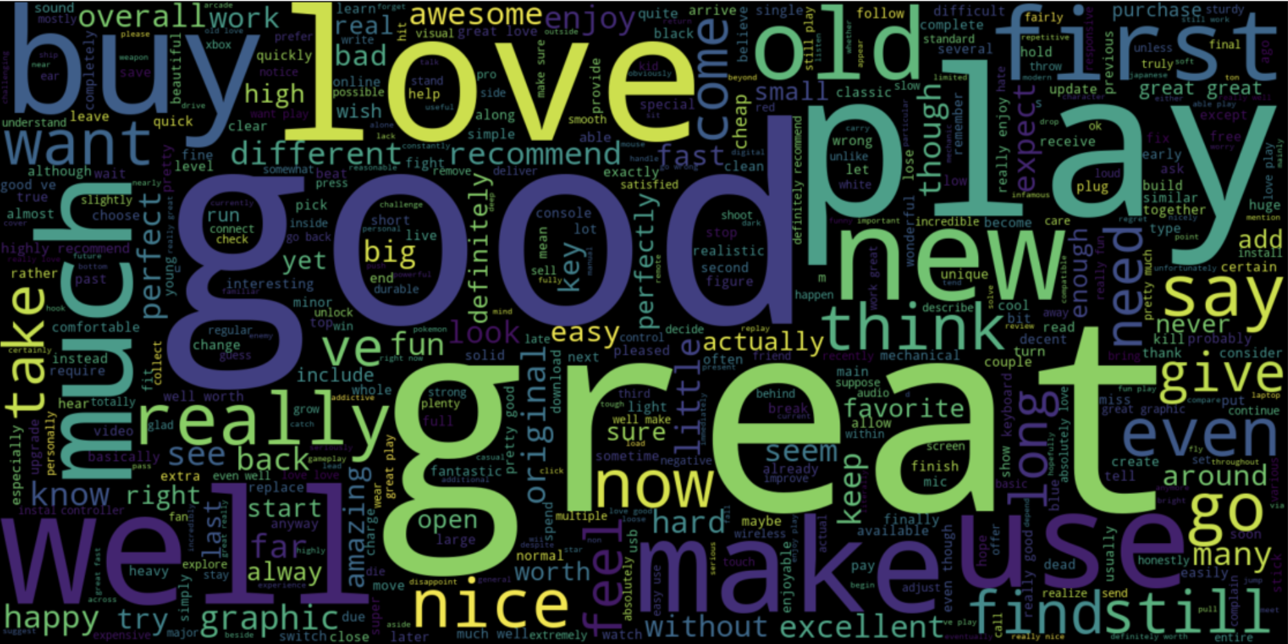
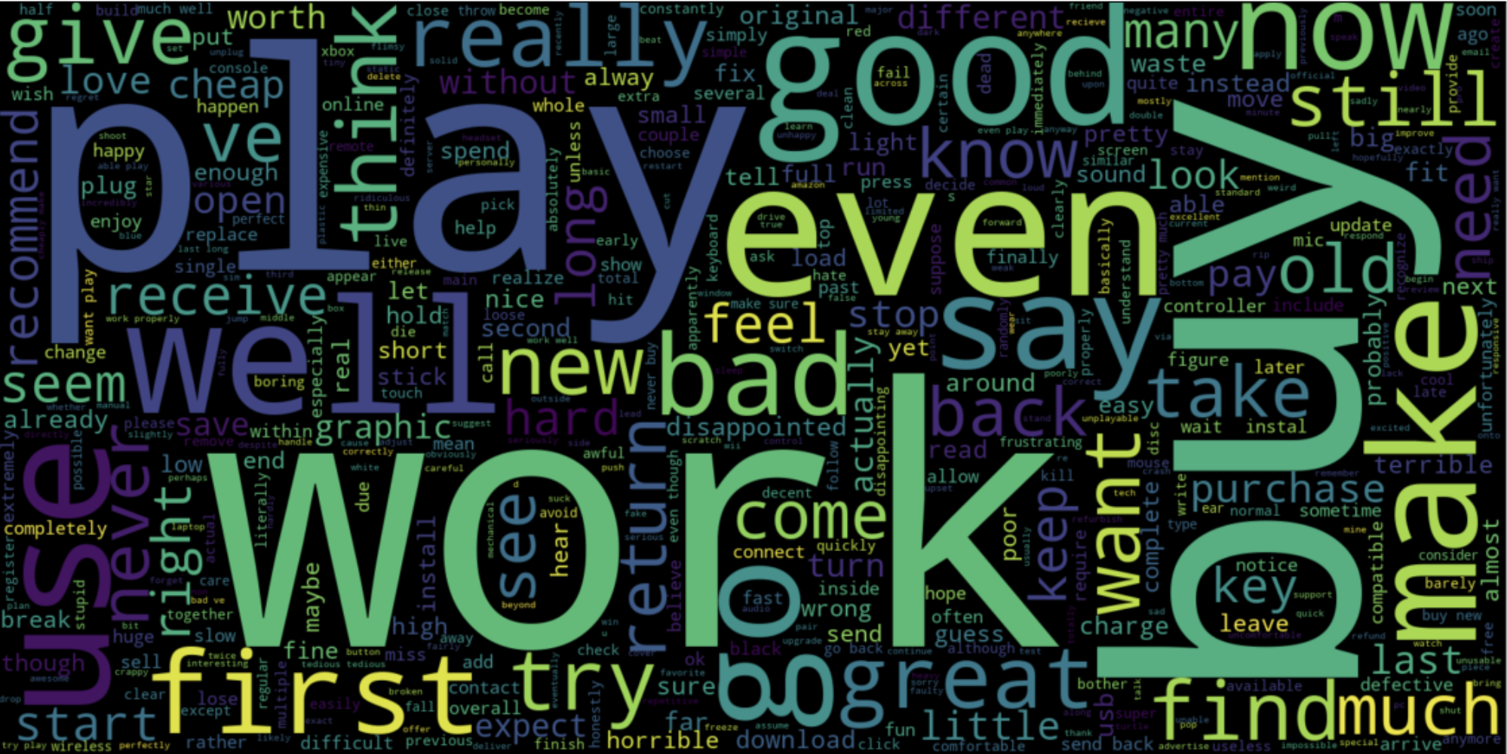
POSITIVE
WordCloud
NEGATIVE
13
Notes:
Source images : Powerpoint Stock Images

Slide 14
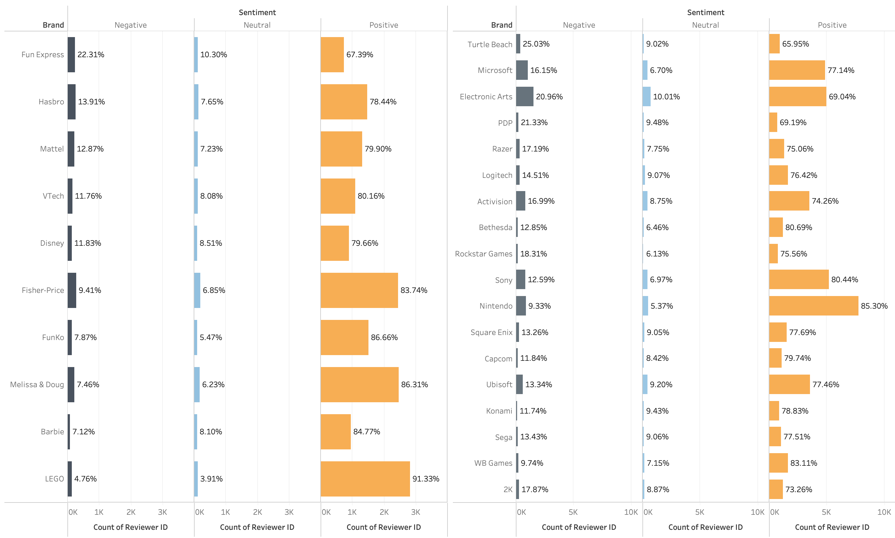
Toys & Game
Video Games
Bad
Influencers
Notes:
Source images : Powerpoint Stock Images

Slide 15
Conclusion
In our analysis we discovered that that less than 20 % of the customers are dissatisfied so only minor change are required to improve the user satisfaction towards our products
Suggestions
Improve Sales : Improve the sales on summer months by organising a few sales to pique the interest of the users in the products of the two main categories (February- June) since the sales are uniform throughout the period.
Restock : Before winter season the products(especially the popular products) should be restocked as the sales in winters increase dramatically
Improve user Satisfaction:-As per our analysis of the brands with respect to dissatisfied customers compared to the overall per of dissatisfied customers.(brand should have more than 1000 reviews)
We discovered that TURTLE BEACH is receiving 25% dissatisfied customers which is allot higher than 12% of overall dissatisfied customers.
We discovered that FUN EXPRESS is receiving 22% dissatisfied customers which is allot higher than 17% of overall dissatisfied customers.
The sellers associated with these brands need to be investigated to find root cause of the dissatisfaction of the customers with respect to sellers
15

Slide 16
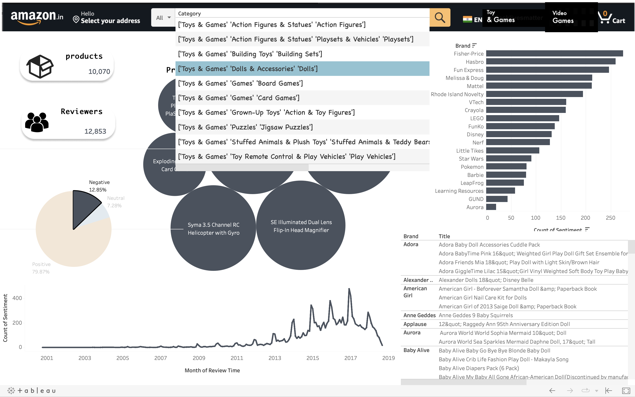
Optimised Inventory DashBoard
Brand
Products & Reviewers
Products
Sentiments
Sentiment Frequency
Over a year
Brand & Product
DashBoard

Slide 17
HOW WE WORKED?

Slide 18
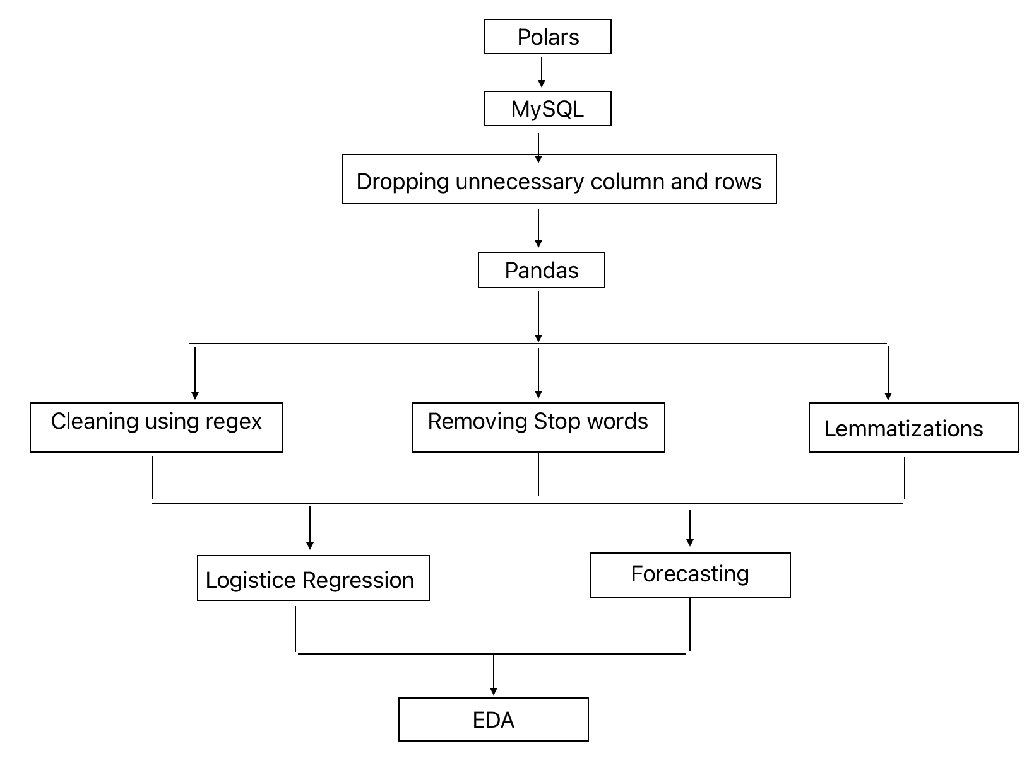
Work Flow

Slide 19
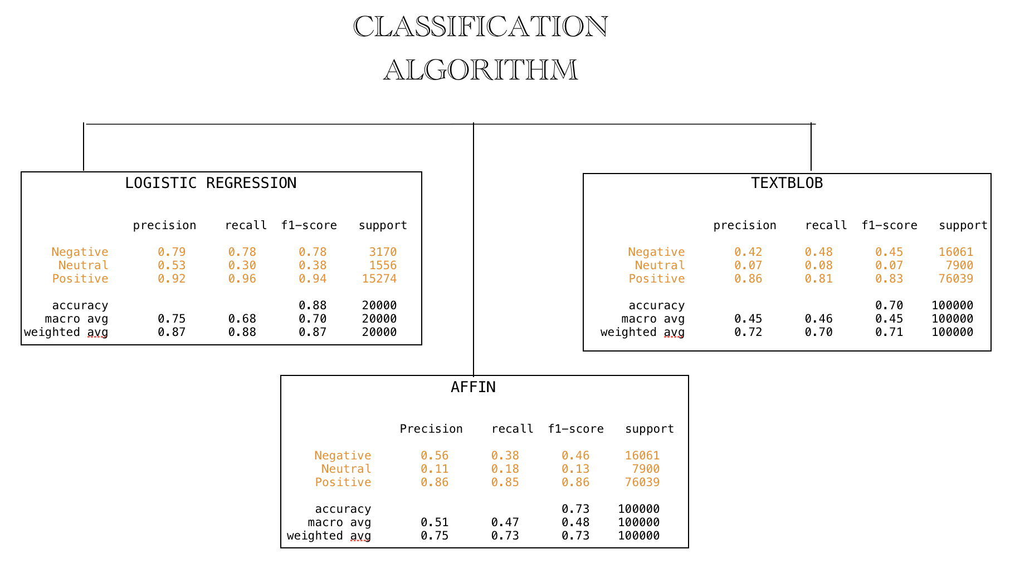
Predective Model

Slide 20







THANK YOU

